Slide 1
Replication of Viruses
Dr. Sonal Mishra

Slide 2
Viral Attack
Viruses are very specific as to which species they attack
HOST specific
Humans rarely share viral diseases with other animals
Eukaryotic viruses usually have protective envelopes made from the host cell membrane

Slide 3
5 Steps of Lytic Cycle
1. Attachment to the cell
2. Penetration (injection) of viral DNA or RNA
3. Replication (Biosynthesis) of new viral proteins and nucleic acids
4. Assembly (Maturation) of the new viruses
5. Release of the new viruses into the environment (cell lyses)

Slide 4
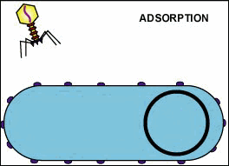
Bacteriophage Replication
Bacteriophage inject their nucleic acid
They lyse (break open) the bacterial cell when replication is finished

Slide 5
Lytic Cycle Review
Attachment Phage attaches by tail fibers to
host cell
Penetration Phage lysozyme opens cell wall,
tail sheath contracts to force tail core and DNA into cell
Biosynthesis Production of phage DNA
and proteins
Maturation Assembly of phage particles
Release Phage lysozyme breaks cell wall

Slide 6
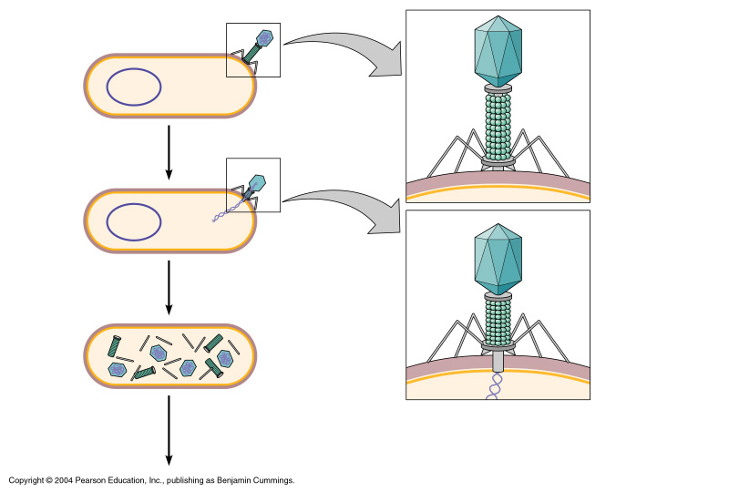
Bacterial cell wall
Bacterial chromosome
Capsid
DNA
Capsid
Sheath
Tail fiber
Tail
1
Attachment:
Phage attaches to host cell.
Base plate
Pin
Cell wall
Plasma membrane
2
Penetration:
Phage pnetrates host cell and injects its DNA.
Sheath contracted
Tail core
3
Merozoites released into bloodsteam from liver may infect new red blood cells

Slide 7
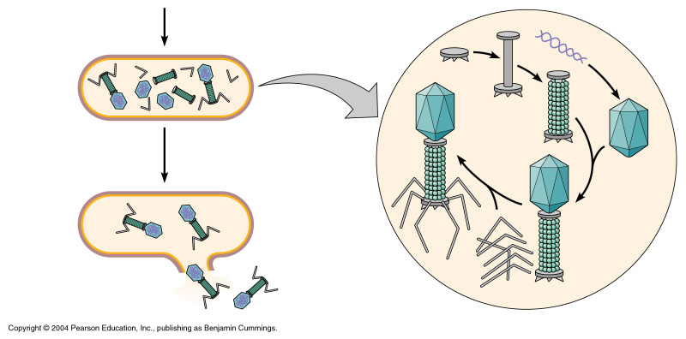
Tail
DNA
4
Maturation:
Viral components are assembled into virions.
Capsid
5
Release:
Host cell lyses and new virions are released.
Tail fibers

Slide 8
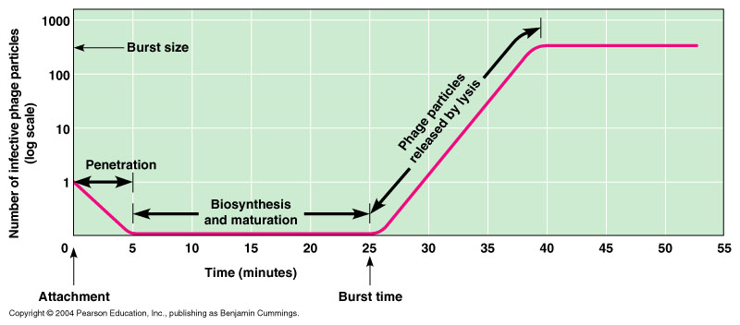
One-step Growth Curve

Slide 9
Viral Latency
Some viruses have the ability to become dormant inside the cell
Called latent viruses
They may remain inactive for long periods of time (years)
Later, they activate to produce new viruses in response to some external signal
HIV and Herpes viruses are examples

Slide 10
Lysogenic Cycle
Phage DNA injected into host cell
Viral DNA joins host DNA forming a prophage
When an activation signal occurs, the phage DNA starts replicating

Slide 11
Lysogenic Cycle
Viral DNA (part of prophage) may stay inactive in host cell for long periods of time
Replicated during each binary fission
Over time, many cells form containing the prophages

Slide 12
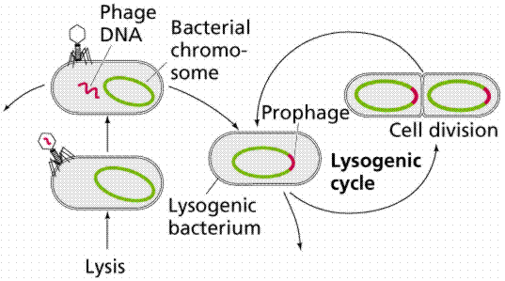
Viral Latency
Once a prophage cell is activated, host cell enters the lytic cell
New viruses form a & the cell lyses (bursts)
Virus said to be virulent (deadly)
ACTIVE
STAGE
INACTIVE STAGE

Slide 13
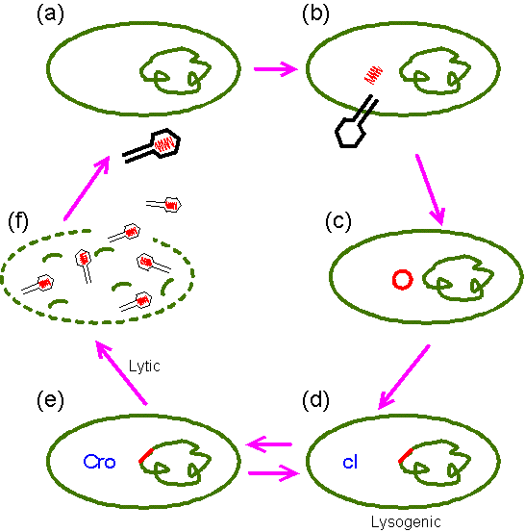
Virulent Viruses
HOST CELL LYSES & DIES

Slide 14
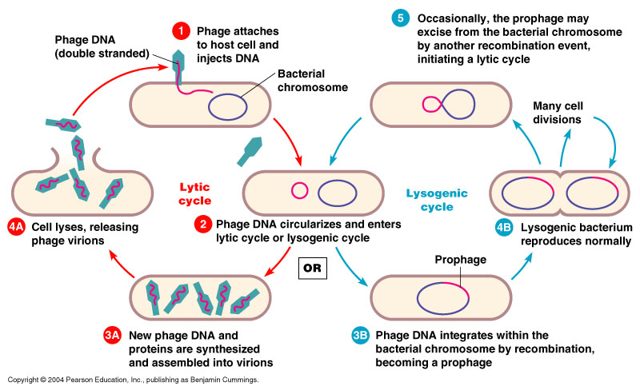
The Lysogenic Cycle

Slide 15
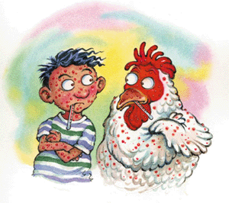
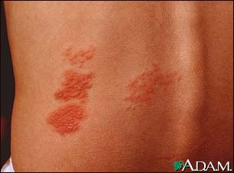
Latency in Eukaryotes
Some eukaryotic viruses remain dormant for many years in the nervous system tissues
Chickenpox (caused by the virus Varicella zoster) is a childhood infection
It can reappear later in life as shingles, a painful itching rash limited to small areas of the body
SHINGLES

Slide 16
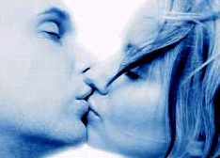
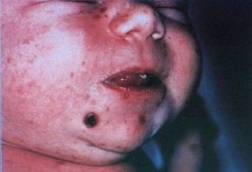
Latency in Eukaryotes
Herpes viruses also become latent in the nervous system
A herpes infection lasts for a person’s lifetime
Genital herpes (Herpes Simplex 2)
Cold sores or fever blisters (Herpes Simplex1)
SKIN TO SKIN CONTACT
PASSED AT BIRTH TO BABY

Slide 17

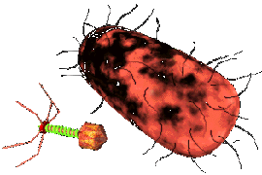
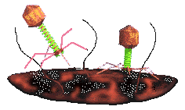
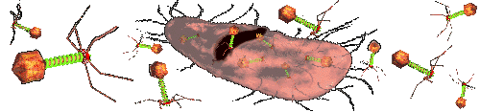
Virulence
VIRUS DESTROYING HOST CELL

Slide 18
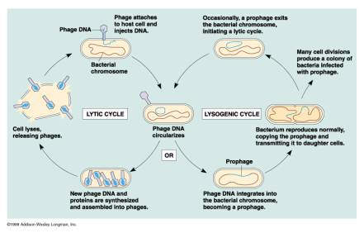
Lytic and Lysogenic Cycles

Slide 19

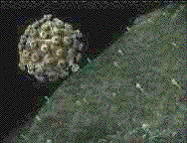
Replication
5 STEPS:
1. ABSORPTION
2. PENETRATION
3. SYNTHESIS OF VIRAL COMPONENTS
4. MATURATION
5. RELEASE
lytic- the cell membrane of the host is completely destroyed, killing the cell
lysogenic- lays dormant until lytic cycle
budding- mature viruses leave the cell a few at a time.
http://www.microbiologybytes.com/introduction/structure.html

Slide 20
Lytic cycle
Viruses that cause host cell to burst are referred to as virulent viruses

Slide 21
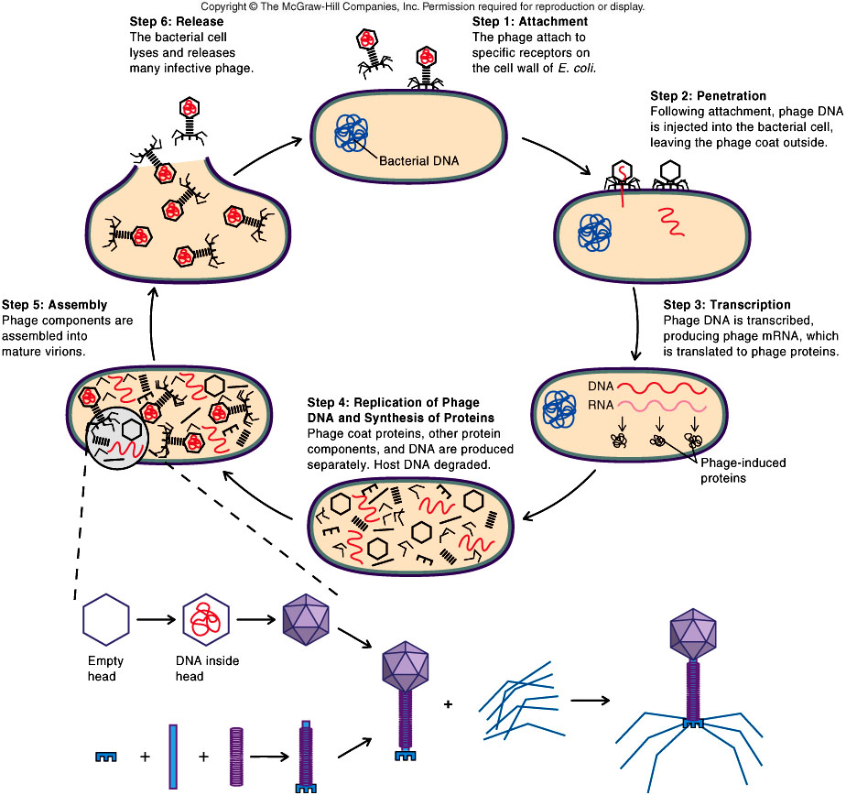
Step 1: virus attaches
Step 6: host cell bursts, releasing
newly-constructed viruses into
the environment to
infect other host
cells
Step 2: virus inserts
nucleic acid
Step 5: viral parts
are assembled into
new viruses
Step 3: host cell’s DNA
is destroyed
Step 4: virus takes over cell’s
metabolism and viral parts are
constructed

Slide 22
Lysogenic cycle
Virus attaches to host
Inserts nucleic acid
Viral DNA incorporates itself into host’s DNA
Provirus reproduced when host cell reproduces
Lysogenic phase continues
Provirus emerges and enters
lytic cycle

Slide 23
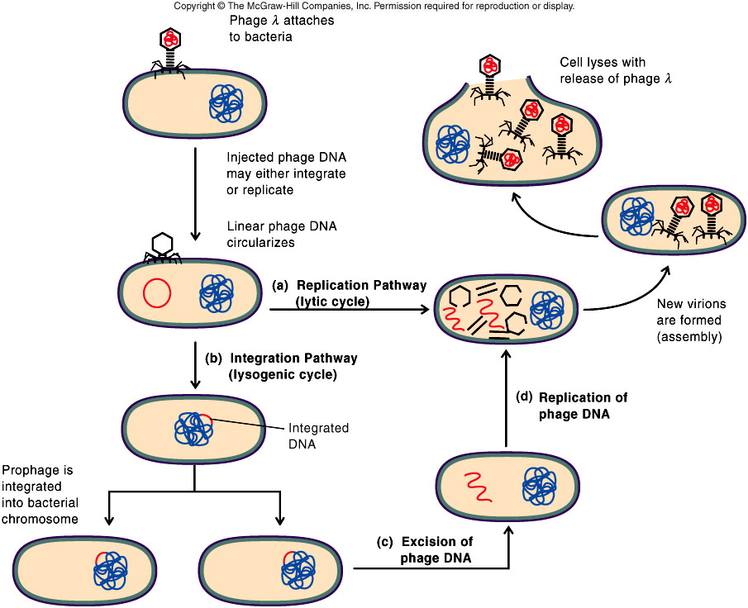
Step 1: virus attaches
Step 2: virus inserts
nucleic acid
Step 3: viral
DNA is incorporated
into host
cell’s forming
provirus
Step 6: provirus pops out of DNA
and enters lytic cycle
Step 5: lysogenic phase continues
Step 4: Provirus is
replicated when host
cell replicates

Slide 24
Common Viruses
Virus-causing diseases
Epstein-Barr Hantavirus
Hepatitis Herpes
HIV Influenza
Marbury/Ebola Measles
Polio Rabies
Rubella Smallpox
Yellow Fever
Epstein-Barr Hantavirus
Hepatitis Herpes
HIV Influenza
Marbury/Ebola Measles
Polio Rabies
Rubella Smallpox
Yellow Fever

Slide 25
Treatment for Viral Disease

Slide 26
Vaccines
An attenuated virus is a weakened, less vigorous virus
“Attenuate" refers to procedures that weaken an agent of disease (heating)
A vaccine against a viral disease can be made from an attenuated, less virulent strain of the virus
Attenuated virus is capable of stimulating an immune response and creating immunity, but not causing illness

Slide 27
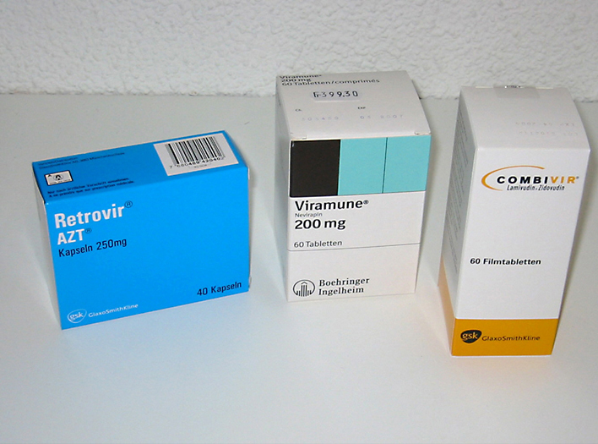
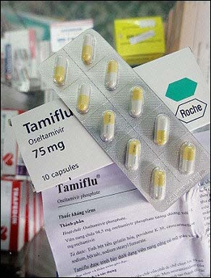
Other Viral Treatments
Interferon are naturally occurring proteins made by cells to fight viruses
Genetic altering of viruses (attenuated viruses)
Antiviral drugs (AZT)
Protease inhibitors – prevent capsid formation

Slide 28
DNA Viruses
Adenovirus
Molluscum Contagiosum Virus
(one-half scale)
Papillomavirus
Hepatitis B Virus
Herpes Simplex Virus

Slide 29
RNA Virus Pictures
RNA Viruses
Influenzavirus
Paramyxovirus
Enterovirus
Rotavirus
Rift Valley Fever Virus

Slide 30
RNA transforming viruses
Picornaviridae- single stranded positive sense; common cold
Orthomyxoviridae- segmented single stranded negative sense; influenza
Paramyxoviridae- single stranded negative sense; measles
Reoviridae- segmented double stranded; respiratory and gastrointestinal infections
Retroviridae- single stranded (2) strands positive sense; AIDS, tumors

Slide 31
Virusoids, Viroids, Prions
Prions are infectious proteins
Viroids are common plant pathogens which are a serious economic problem; smaller than viruses
Virusoids belong to a larger group of infectious agents called satellite RNAs, found in bacteria, plants, fungi, invertebrates and vertebrates. Satellite genomes encode proteins, satellite viruses encode capsid proteins

Slide 32
Plant virology
Seeds: transmit virus infection due to external contamination of the seed with virus particles, or because of infection of the living tissues of the embryo.
Vegetative propagation/grafting: These techniques of plant propagation provide the opportunity for viruses to spread to new plants.
Vectors: Many different groups of living organisms can act as vectors and spread viruses from one plant to another:bacteria, fungi, nematodes
necrosis, hypoplasia, hyperplasia

Slide 33
Gene Silencing
Antisense technology
geneticists can inactivate a gene that may cause disease or be defective
highly specific method
  make an RNA strand 15-20 bases in length complementary to the mRNA. The synthesized RNA will attach itself to the mRNA and prevent that portion of the mRNA from creating the gene on the duplicate DNA strand
used to treat several viruses including AIDS, Herpes, Chicken Pox, and Hepatitis

Slide 34
Viral Replication
•Common stages of viral replication cycle:
1.Adsorption: the attachment of viruses to host cells.
2.Penetration: the entry of virions (or their genome) into host cells.
3.Synthesis: the synthesis of new nucleic acid molecules, capsid proteins & other viral components using the host cell’s machinery.
4.Maturation: assembly of newly synthesized viral components into complete virions.
5.Release: release of new virions from host cells. Frequently this step causes lysis of host cells.

Slide 35
Replication of Bacteriophages
•Steps of bacteriophage replication: (T4 phage):
1.Adsorption: the attachment of viruses to host cells. It is a chemical attraction process. Specific proteins found in tail fibers bind to specific receptor sites on host cells. Some bind to cell wall, others bind to flagella or pili.
2.Penetration: lysozyme (present in phage tail) weakens bacterial cell wall, tail contracts, the hollow tube penetrates the cell wall & contacts cell membrane. Viral DNA is then injected & the capsid remains outside.
3.Synthesis: phage DNA controls host cell’s metabolic machinery, bacterial DNA is disrupted & the resulting nucleotides are used to build new phage DNA. Phage DNA → transcribed mRNA → translated on host ribosomes → proteins (e.g. capsid + enzymes).

Slide 36
Replication of Bacteriophages
Steps of bacteriophage replication:
4.Maturation: assembly of newly synthesized viral components into complete virions. In host cytoplasm, heads are assembled, dsDNA is packed into each head, also phage tail & collar are assembled.
5.Release: lysozymes (coded by phage genes) breaks down cell wall allowing viruses to escape, i.e. bacterial cell is lysed, new phages can now infect more bacterial cells.
–Phages that lyse & destroy the host cell are called lytic phages (virulent phage). In this case, the replication cycle is called lytic cycle.

Slide 37
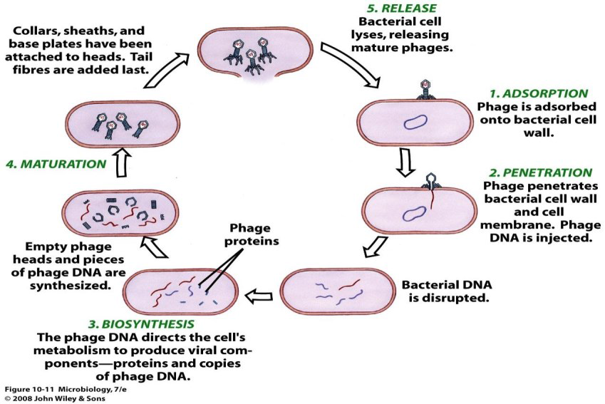

Slide 38
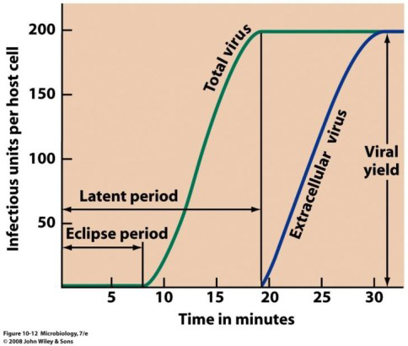
Phage Growth
•Replication curve
–Eclipse period: from penetration to biosynthesis, in this period mature virions are not detected in host cell.
–Latent period: from penetration up to phage release. This period includes eclipse period.
–After eclipse period the no. of released viruses per host cell rises & then levels off.
–Eclipse period = Lag phase in bacteria.

Slide 39
Estimation of Phage Numbers
•Phage assay (plaque assay) is a method used to estimate the number of phages in a sample (phage titer).
•Procedures:
1.Prepare plates containing susceptible bacterial lawn (layer of bacteria).
2.Make serial dilution of phage suspension.
3.From each dilution take a sample (small volume) & inoculate onto the plate containing susceptible bacterial lawn.
4.During incubation, each phage will infect a bacterial cell & the phages produced from each bacterium will lyse the bacterium & the surrounding bacteria, this will result in the appearance of clear zones on the bacterial lawn called plaques.
5.After incubation, count the no. of plaques x dilution factor = no. of phages (plaque forming units / PFU).

Slide 40
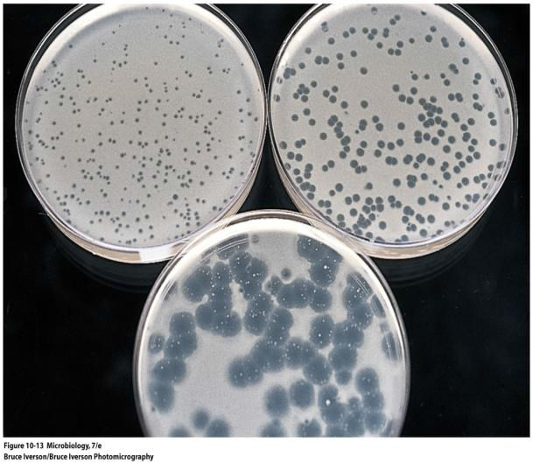
Estimation of Phage Numbers

Slide 41
Lysogeny
•Lysogeny: a stable long-term relationship between the phage & its host cell where phage nucleic acid is incorporated into the host nucleic acid and becomes a prophage.
–Together, the prophage and the involved bacterial cell are called lysogenic cell (lysogen).
•Virulent (lytic) phages: destroy their host cells.
•Temperate phages (lysogenic phage): for some time they may undergo a lytic cycle but most of the time they exhibit lysogeny.
• The prophage remains dormant for a long time & when bacterial cell divides, the prophage multiplies as part of the bacterial chromosome.

Slide 42
Lysogeny
•The inserted prophage may have genes that alter the phenotype of the bacterial cell, a process known as lysogenic conversion.
•Lysogenic conversion may:
Repress virus replication.
Provide ‘immunity’ to infection by other phages, i.e. by preventing their adsorption or biosynthesis.
Increase pathogenicity and/or virulence of lysogenic bacterial cells, i.e. by exotoxins release.
E.g. Corynebacterium diphtheria & Clostridium botulinum don’t cause disease unless they are infected by a lysogenic phage, once they have a prophage that include genes coding for exotoxins →exotoxin release by bacteria → tissue damage.

Slide 43
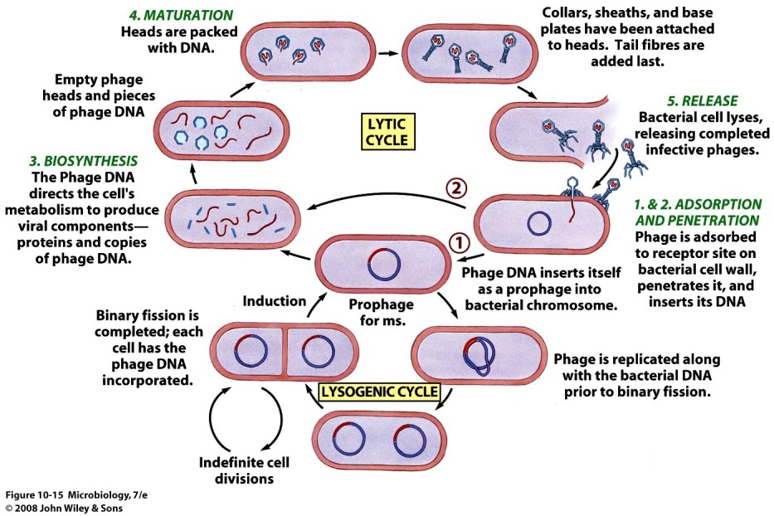

Slide 44
Lysogeny
•Lysogenic cycle lasts as long as the bacteria is growing while the prophage in it.
•Due to a certain stimulant (e.g. lack of nutrients or toxic chemicals to the lysogen) or even spontaneously, the prophage can become active & starts the lytic cycle, a process called induction.
•Through induction the provirus removes itself from the bacterial chromosome, phage DNA then codes for viral proteins, enzymes & other components and the cycle is completed as a lytic cycle.
•The majority of bacteriophages are believed to undergo lysogeny.

Slide 45
Replication of Animal Viruses
Animal viruses: viruses that infect humans and animals.
1.Adsorption:
–Naked viruses have attachment sites (proteins) on the surfaces of their capsids e.g. (canyons or depressions) that bind to specific receptors on host cells.
–Enveloped viruses have spikes that recognize a membrane protein receptor on the surface of host cell.
2.Penetration:
–Nucleic acid & capsid penetrate animal cell (unlike phages only nucleic acid is injected).
–Naked viruses enter cells by endocytosis (pit-like region on cell surface) & enter the cell as vesicles.
–Enveloped viruses either fuse with host plasma membrane or enter by endocytosis.
–Once inside cell cytoplasm, un-coating (release of viral genome) from protein coat occurs by proteolytic enzymes.

Slide 46
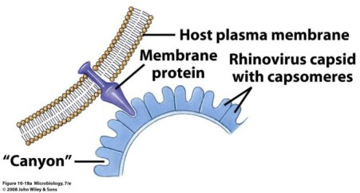
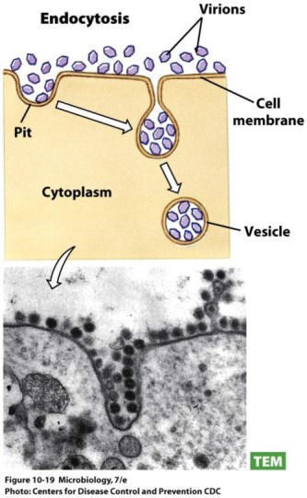
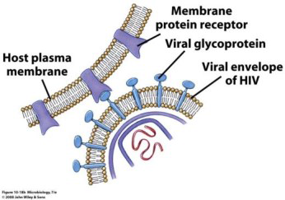

Slide 47
Replication of Animal Viruses
3.Synthesis:
–DNA viruses: DNA replicates in host nucleus while capsid & other proteins are synthesized in cytoplasm. The new viral proteins move to the nucleus & combine with new viral DNA to form virions.
–RNA viruses: synthesis undergoes in greater variety than DNA. (RNA & RNA retroviruses).
4.Maturation:
–When viral components are available in abundant amounts, assembly into virions starts.
–Envelope lipids & glycoproteins are synthesized by host enzymes.
–If the virus is of enveloped type, the virion is incomplete until it buds through one of the host membranes, e.g. plasma membrane, nuclear membrane, Golgi or endoplasmic reticulum.
5.Release:
–The budding of new virions may or may not kill the host cell (herpes & pox viruses cause lysis to cells).

Slide 48
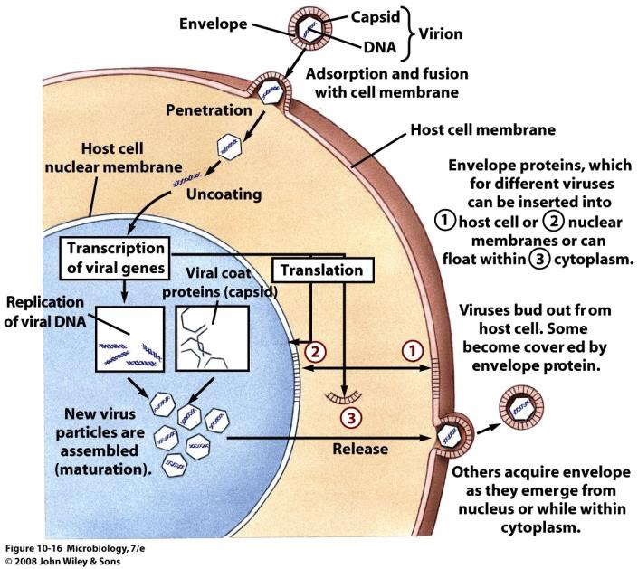

Slide 49
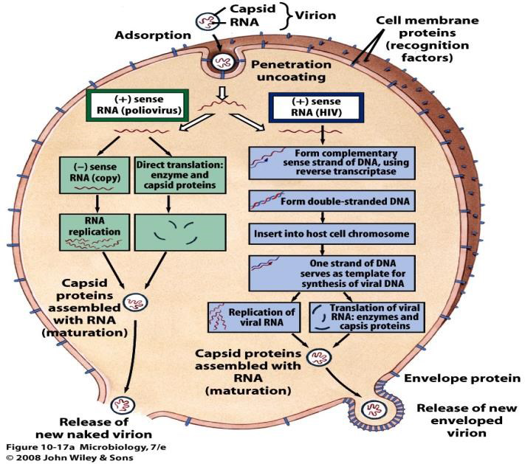

Slide 50
Culturing Animal Viruses
Viruses have to be grown in living tissue.
First they were cultured in living animals, later in chick embryo, recently in cell culture (tissue culture).
Primary purposes of viral cultivation:
  To isolate and identify viruses in clinical specimens.
  To prepare viruses for vaccines.
  To do detailed research on viral structure, multiplication cycles, genetics, and effects on host cells.

Slide 51
Culturing Animal Viruses
1. ANIMALS
2. EMBRYONATED EGGS
3. CELL CULTURE

Slide 52
Culturing Animal Viruses
ANIMALS
Advantages
Testing new viral vaccines or new antiviral drugs.
Some viruses e.g. hepatitis B, papillomaviruses and other agents e.g. prions (BSE, scrapie) will not grow in cell culture.
Studies on pathogenesis to model human disease (including the use of transgenic animals). Transgenic animals are animals (most commonly mice) that have had a foreign gene deliberately inserted into their genome.
Source of primary cell cultures.
Production of antibodies for diagnostic and research purposes.

Slide 53
Culturing Animal Viruses
ANIMALS
Disadvantages
Expensive.
Complex systems making it difficult to discern events during the infection.
Have their own indigenous viruses, some of which may interfere with the experiment or in some cases are dangerous to humans e.g. Marburg virus, herpes B virus, Covid-19.

Slide 54
Culturing Animal Viruses
Animal models
Symptoms and signs
increased temperature
circling (Walk in circles around their longitudinal axis)
sneezing
rash
pustules/pocks
Death

Slide 55
Culturing Animal Viruses
Tissues
Post-infection/post-mortem histology
inclusion bodies (sometimes called elementary bodies, are nuclear or cytoplasmic aggregates of stable substances, usually proteins. They typically represent sites of viral multiplication in a bacterium or an eukaryotic cell and usually consist of viral capsid proteins)
inflammatory response
cell death/necrosis

Slide 56
Culturing Animal Viruses
EMBRYONATED EGGS
Advantages
More convenient and less expensive than animals.
More easily manipulated for study.
Disadvantages
Only susceptible to a small range of viruses.
Requirement for large and specialized incubator that allows “rocking” of eggs.
Requirement for reliable supplies of fertilized eggs.

Slide 57
Culturing Animal Viruses
Embryonated eggs
Effect on embryo
slow growth
death

Slide 58
Culturing Animal Viruses
CELL CULTURE
Media
Balanced salt solution + glucose
Amino acids and vitamins
Antibiotics
Penicillin/streptomycin (crystamycin)
Antifungal agent e.g. fungizone
pH regulation (Sodium bicarbonate/CO₂)

Slide 59
Culturing Animal Viruses
Cell culture :
• Animal cells are taken freed from surrounding tissue by enzymes, washed, counted & dispensed into plastic flasks, tubes or bottles containing nutrients.
• Antibiotics are added to prevent microbial contamination.
• Cells will attach to plastic surface, multiply & spread to form sheets, one cell-thick called ‘monolayers’. When the sheet of cells fill the surface area available, the culture is said to be “confluent.”
• Monolayers can be sub-cultured; a process where cells from a culture are transferred to new container with fresh nutrients (passage).
–Plaque assay similar to that of phages can be used on animal/human cells.

Slide 60
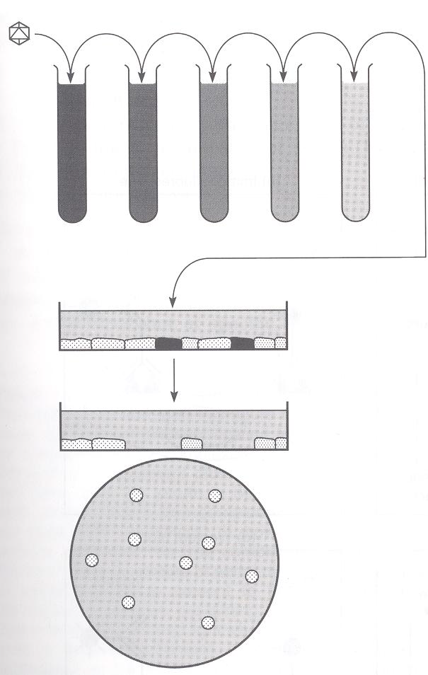
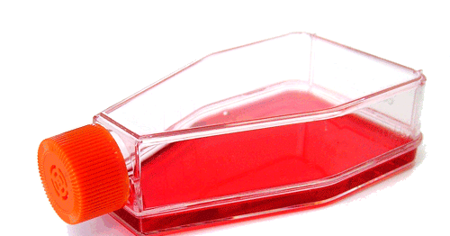
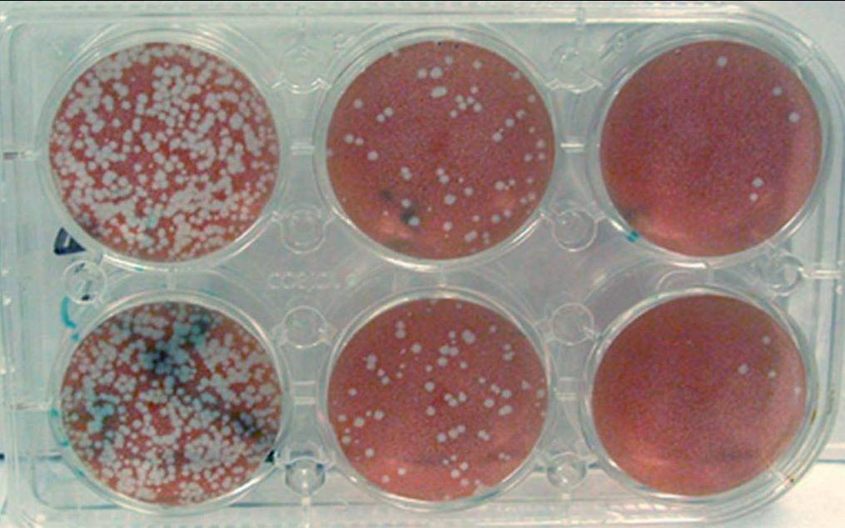
Plaque Assay of animal viruses

Slide 61
Culturing Animal Viruses
Cell culture
1.Primary cultures
A culture taken directly from an organism, often embryonic tissue e.g. chick embryo fibroblasts.
Composed of different cell types with differing susceptibility to viruses, although fibroblast-like cells tend to outgrow other types.
2.Diploid cell lines
Derived from human or animal fetal tissue. At least 75% of the cells have the same karyotype (the number and visual appearance of the chromosomes in the cell nuclei of an organism or species) as the organism from which they were originally obtained e.g. human embryo lung (HEL) cells.

Slide 62
Culturing Animal Viruses
Cell culture
3.Continuous cell lines
Derived from tumours.
Normal cells that have acquired tumour-like properties (“transformed” cells).
Aneuploid (i.e. have an abnormal number of chromosomes. (e.g. HeLa cells)).

Slide 63
Culturing Animal Viruses
Cytopathic effect (CPE) is the visible effect viruses have on cells.
The effect differs according to the infecting virus, e.g. lysis, change in shape of cells, swelling, detachment from adjacent cells or the container.
Not all viruses produce a CPE → need to detect viral antigens, e.g. haemadsorption.

Slide 64
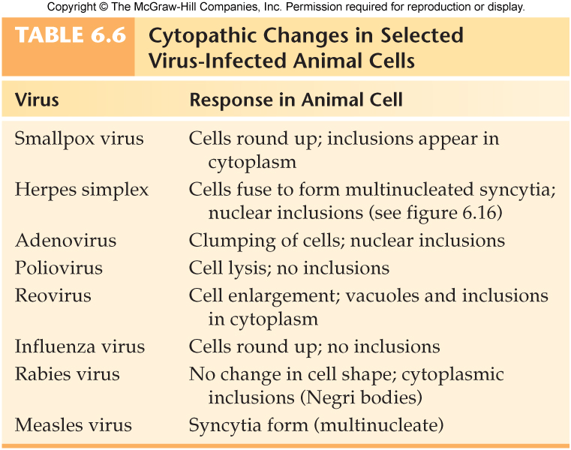
Notes:
multinucleated syncytium result from multiple cell fusions of uninuclear cells.

Slide 65
Viruses and Teratogenesis
•Teratogenesis is the induction of defects during embryonic development.
•Teratogen: an agent that induces such a defect.
•Some viruses act as teratogens, i.e. they can be transferred through placenta & infect the fetus.
–The earlier the embryo is infected, the more the damage can be.
–e.g. cytomegalovirus & rubella cause teratogenic effects.
–If the damage is severe it may lead to death of fetus.
•TORCH screen: series of tests to detect teratogenic diseases in pregnant women & new born infants.
–The test detects antibodies against Toxoplasmosis, disease-causing viruses (usually hepatitis B, varicella), rubella virus, cytomegalovirus & herpes simplex virus.

Slide 66
Viruses and Cancer
Cancer is an uncontrolled and/or invasive growth of abnormal cells.
Tumor or neoplasm (localized accumulation of cells) can be benign, a non-cancerous growth.
But if the cells invade and interfere with the functioning of surrounding normal tissue, the tumor is malignant.
Malignant tumors and their cells can metastasize, or spread, to other tissues in the body.
About 20% of human cancers are caused by viruses (DNA & retro viruses) (Luo and Ou, 2015).

Slide 67
Viruses and Cancer
Although many viruses can cause various tumors in animals, only seven of them are associated with human cancers and are currently considered oncogenic viruses:
–Human papilloma viruses (HPV-16 and HPV-8) cause cervical cancer.
–Epstein-Bar virus affects lymphocytes, causes destruction to the jaw and is associated with some forms of cancer such as Hodgkin's lymphoma, Burkitt's lymphoma and nasopharyngeal carcinoma.
–Hepatitis B &C viruses potentially cause liver cancer.
– Human herpes virus 8 (HHV8) is responsible for Kaposi’s sarcoma often found in patients with acquired immunodeficiency syndrome (AIDS).
– Merkel cell polyomavirus (MCPyV) causes Merkel cell carcinoma.
– Human T-lymphotropic virus (HTLV-1) is the causative agent of adult T-cell lymphoma.

Slide 68
Viruses and Cancer – Viral Oncogenes
Oncogene is a gene that has the potential to cause cancer (onco = mass).
The proteins produced by tumor viruses that cause uncontrolled host cell division come from segments of DNA called oncogenes.
Oncogenes & proto-oncogenes:
oncogenes are viral genes which cause neoplasm & also contain the information for synthesizing viral proteins needed for viral replication.
proto-oncogenes are normal cellular genes that control cell division and can act as oncogenes as a consequence of mutations resulting from the integration of viral DNA within or adjacent to cellular genes.

Slide 69
Virus-Like Agents
•Satellites:
–Small ssRNA molecules (enclosed in a capsid), which lack genes required for their replication.
–They can replicate only in the presence of a helper virus.
– They are not related to (different from) the helper virus.
– Called satellite as their reproduction “revolves around” a helper virus.
–There are 2 types of satellites:
Satellite viruses: code for their capsid protein.
Satellite nucleic acid (virusoid): whose helper virus encodes their capsid.

Slide 70
Virus-Like Agents
•Delta hepatitis (hepatitis delta virus, HDV):
–It is a defective pathogen that requires coinfection with hepatitis B virus (HBV) to replicate, i.e. it is considered a satellite.
–Significantly increases the severity of HBV infection (i.e. increases the mortality rate to 20%).
–Transmitted by blood and can be prevented by vaccination against hepatitis B as it can’t infect without its helper virus.
–It has the smallest genome of any known animal virus.

Slide 71
Virus-Like Agents
•Virophages:
–Similar to satellite viruses in that they can only replicate in presence of a helper (host) virus but they impair their helper virus’s replication.
–e.g. Sputnik virus: it co-infects amoeba cells with a larger virus (Mimivirus) causing the inhibition of its replication.
•Viroids:
–Infectious RNA particles smaller than a virus & don’t require a helper virus for their replication.
–Usually cause plant diseases.

Slide 72
Virus-Like Agents
•Prions:
–Small proteinaceous infectious particle, that cause neurological degenerative diseases such as ‘mad cow disease’.
In cattle, it is called bovine spongiform encephalopathy (BSE); while in humans, it is called Creutzfeldt–Jakob disease (CJD).
–Characteristics of prions:
Resistant to inactivation by heating to 90°C, which usually inactivates viruses.
Prion infection is not sensitive to radiation treatment that damages virus genomes.
Not destroyed by enzymes that digest DNA or RNA.
Sensitive to protein denaturing agents, such as phenol and urea.

Slide 73
Virus-Like Agents
•Prions:
–Prions are normal proteins that become folded incorrectly, possibly as a result of a mutation.
– The harmless normal proteins, from which prions are produced, are found on the plasma membrane of many mammalian cells, especially brain cells.
–The prion proteins (PrP) are thought to stick together inside cells, forming small fibers, or fibrils.
– Because the fibrils cannot be organized in the plasma membrane correctly, such aggregations eventually kill the cell.
–Prions are believed to cause other copies of the normal protein to fold improperly and hence spread the disease.
–Prions move easily from one species to another (by injection or ingestion of contaminated food).

Slide 74
Treatment of Animal Viral Infections
Because they are not bacteria, antibiotics are ineffective.
Antiviral drugs block virus replication by targeting one of the steps in the viral life cycle.
Interferon shows potential for treating and preventing viral infections.
Vaccines stimulate immunity.

Slide 75

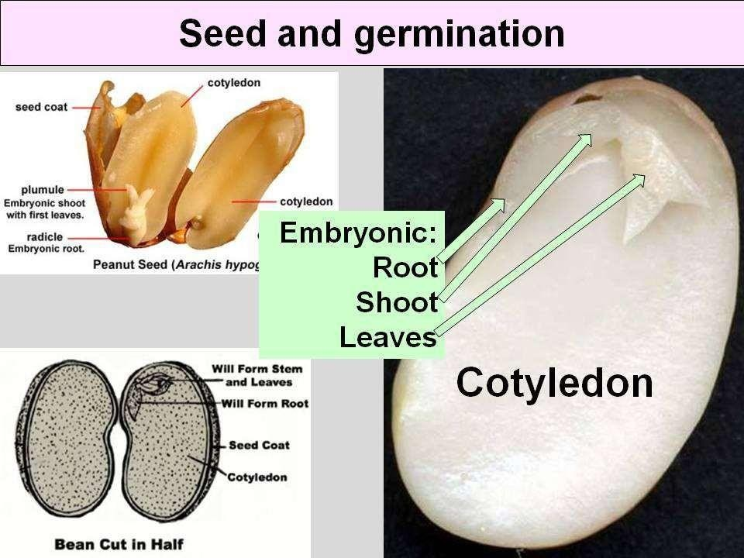


DISTRIBUTION
The virus is distributed at random and can be found in different parts of seed
Embryo; BCMV, CpMv, TRSV
Endosperm: BSMV
Seed coat: BCMV, TMV, TSWV

Slide 76


